Slide 1
FLACADA
Team Members: Nickolas Morales, Mabel Amaya Product Owner: Helen Gonzalez
Instructor: Masoud Sadjadi School of Computing and Information Sciences Florida International University
Final Presentation
Summer C 2017
FLACADA
Notes:
7 seconds.( I will select 2 best slides (i will give them extra points and students will present for CIS committee)
Greet your audience, thank them for attending your presentation, introduce yourself, introduce your project, introduce your team members, and quickly indicate what each of you did in a high-level manner, and put more emphasis on your part/contribution.

Slide 2
FLACADA
Team Members: Nickolas Morales, Mabel Amaya Product Owner: Helen Gonzalez
Instructor: Masoud Sadjadi School of Computing and Information Sciences Florida International University
Final Presentation
Summer C 2017
FLACADA
Notes:
7 seconds.( I will select 2 best slides (i will give them extra points and students will present for CIS committee)
Greet your audience, thank them for attending your presentation, introduce yourself, introduce your project, introduce your team members, and quickly indicate what each of you did in a high-level manner, and put more emphasis on your part/contribution.

Slide 3
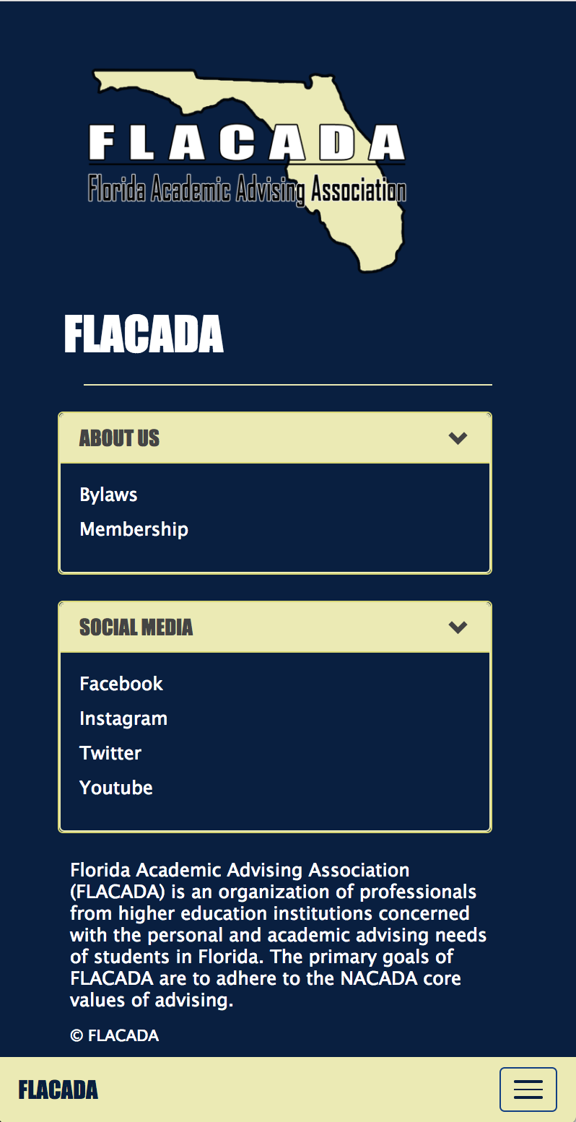
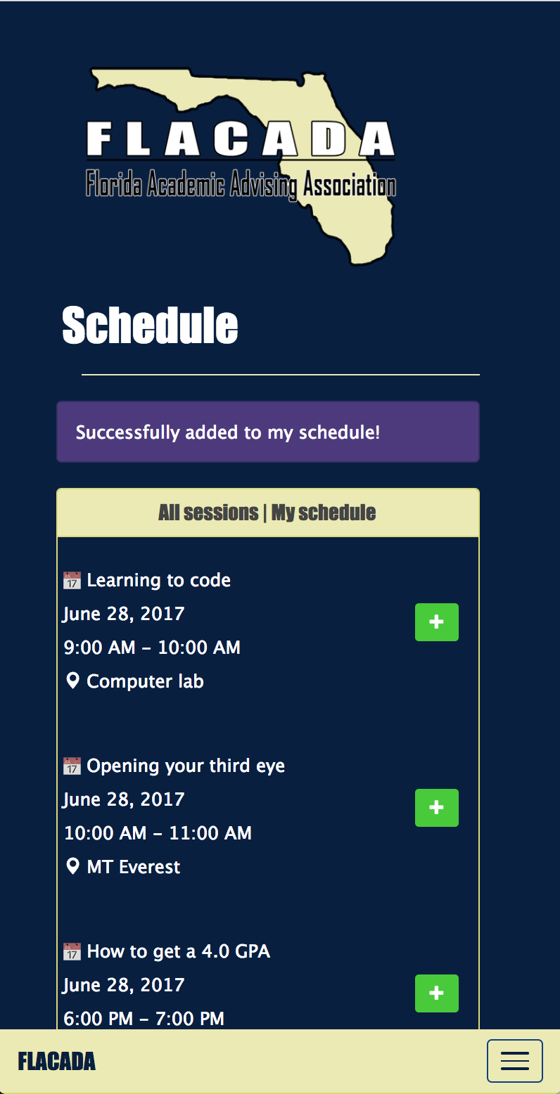
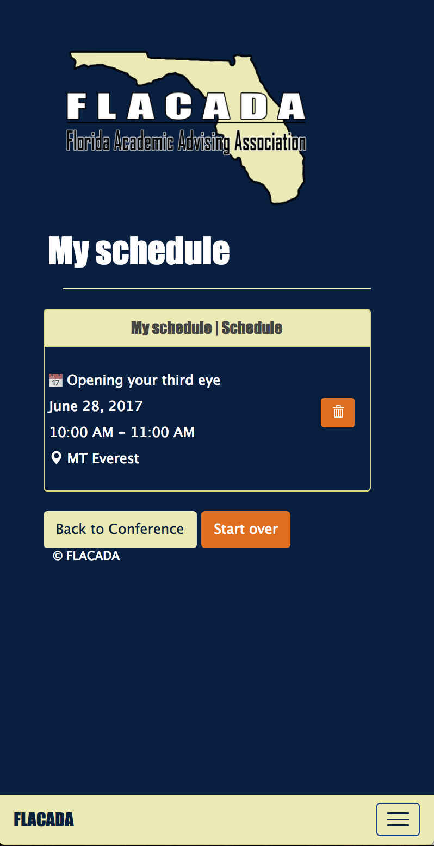
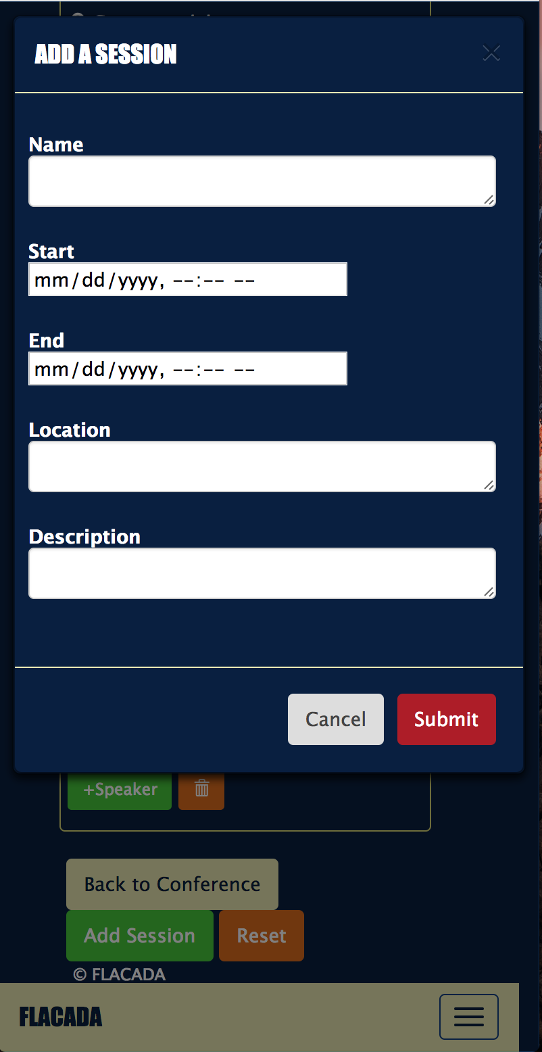
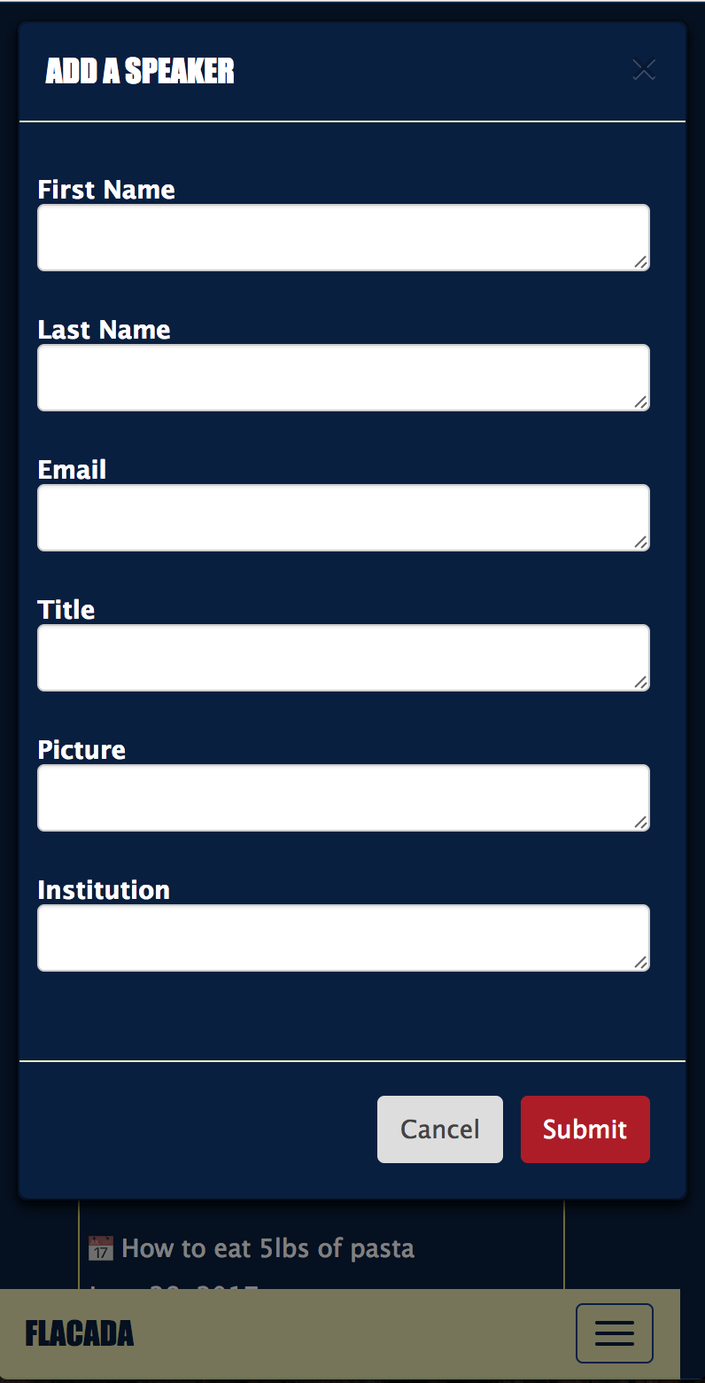
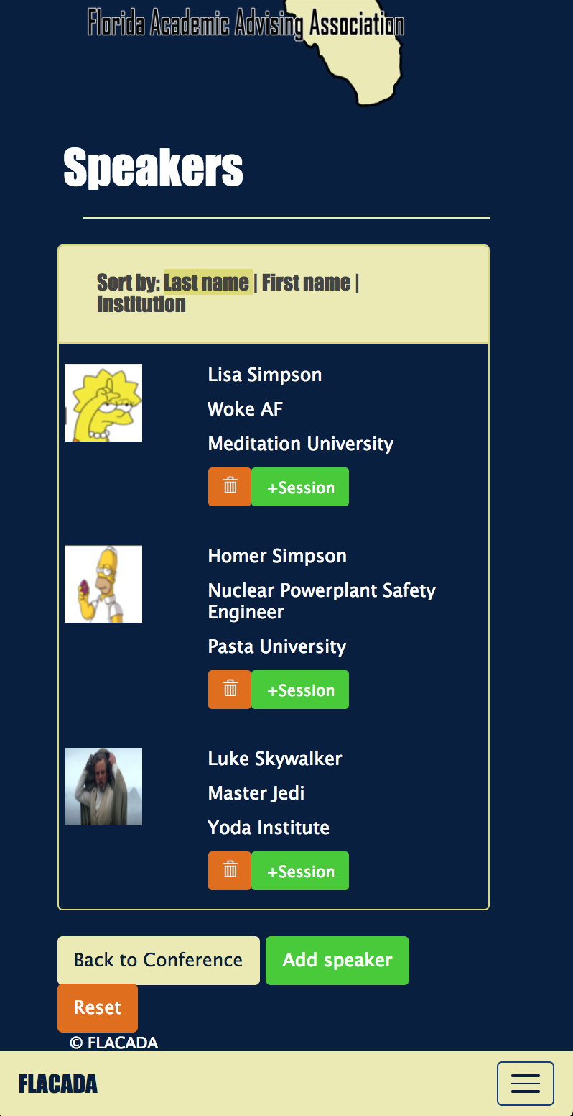
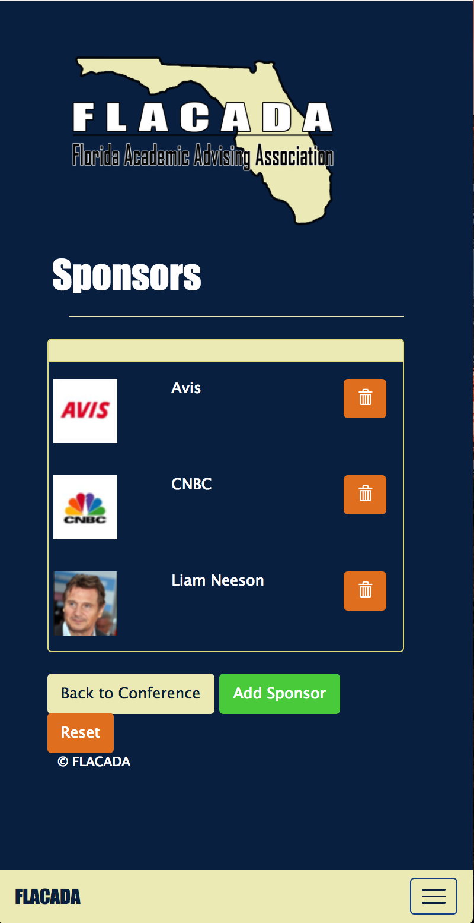
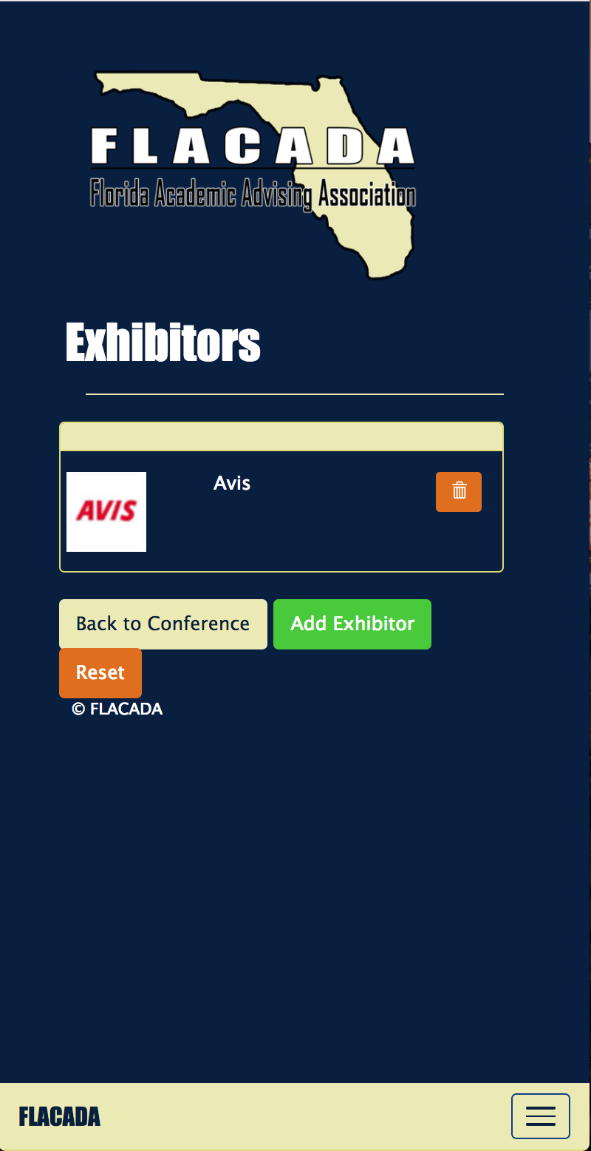
Project definition
Notes:
10 seconds.
Introduce the problem that the whole project (in all versions) tackles with GIF or screenshot.

Slide 4
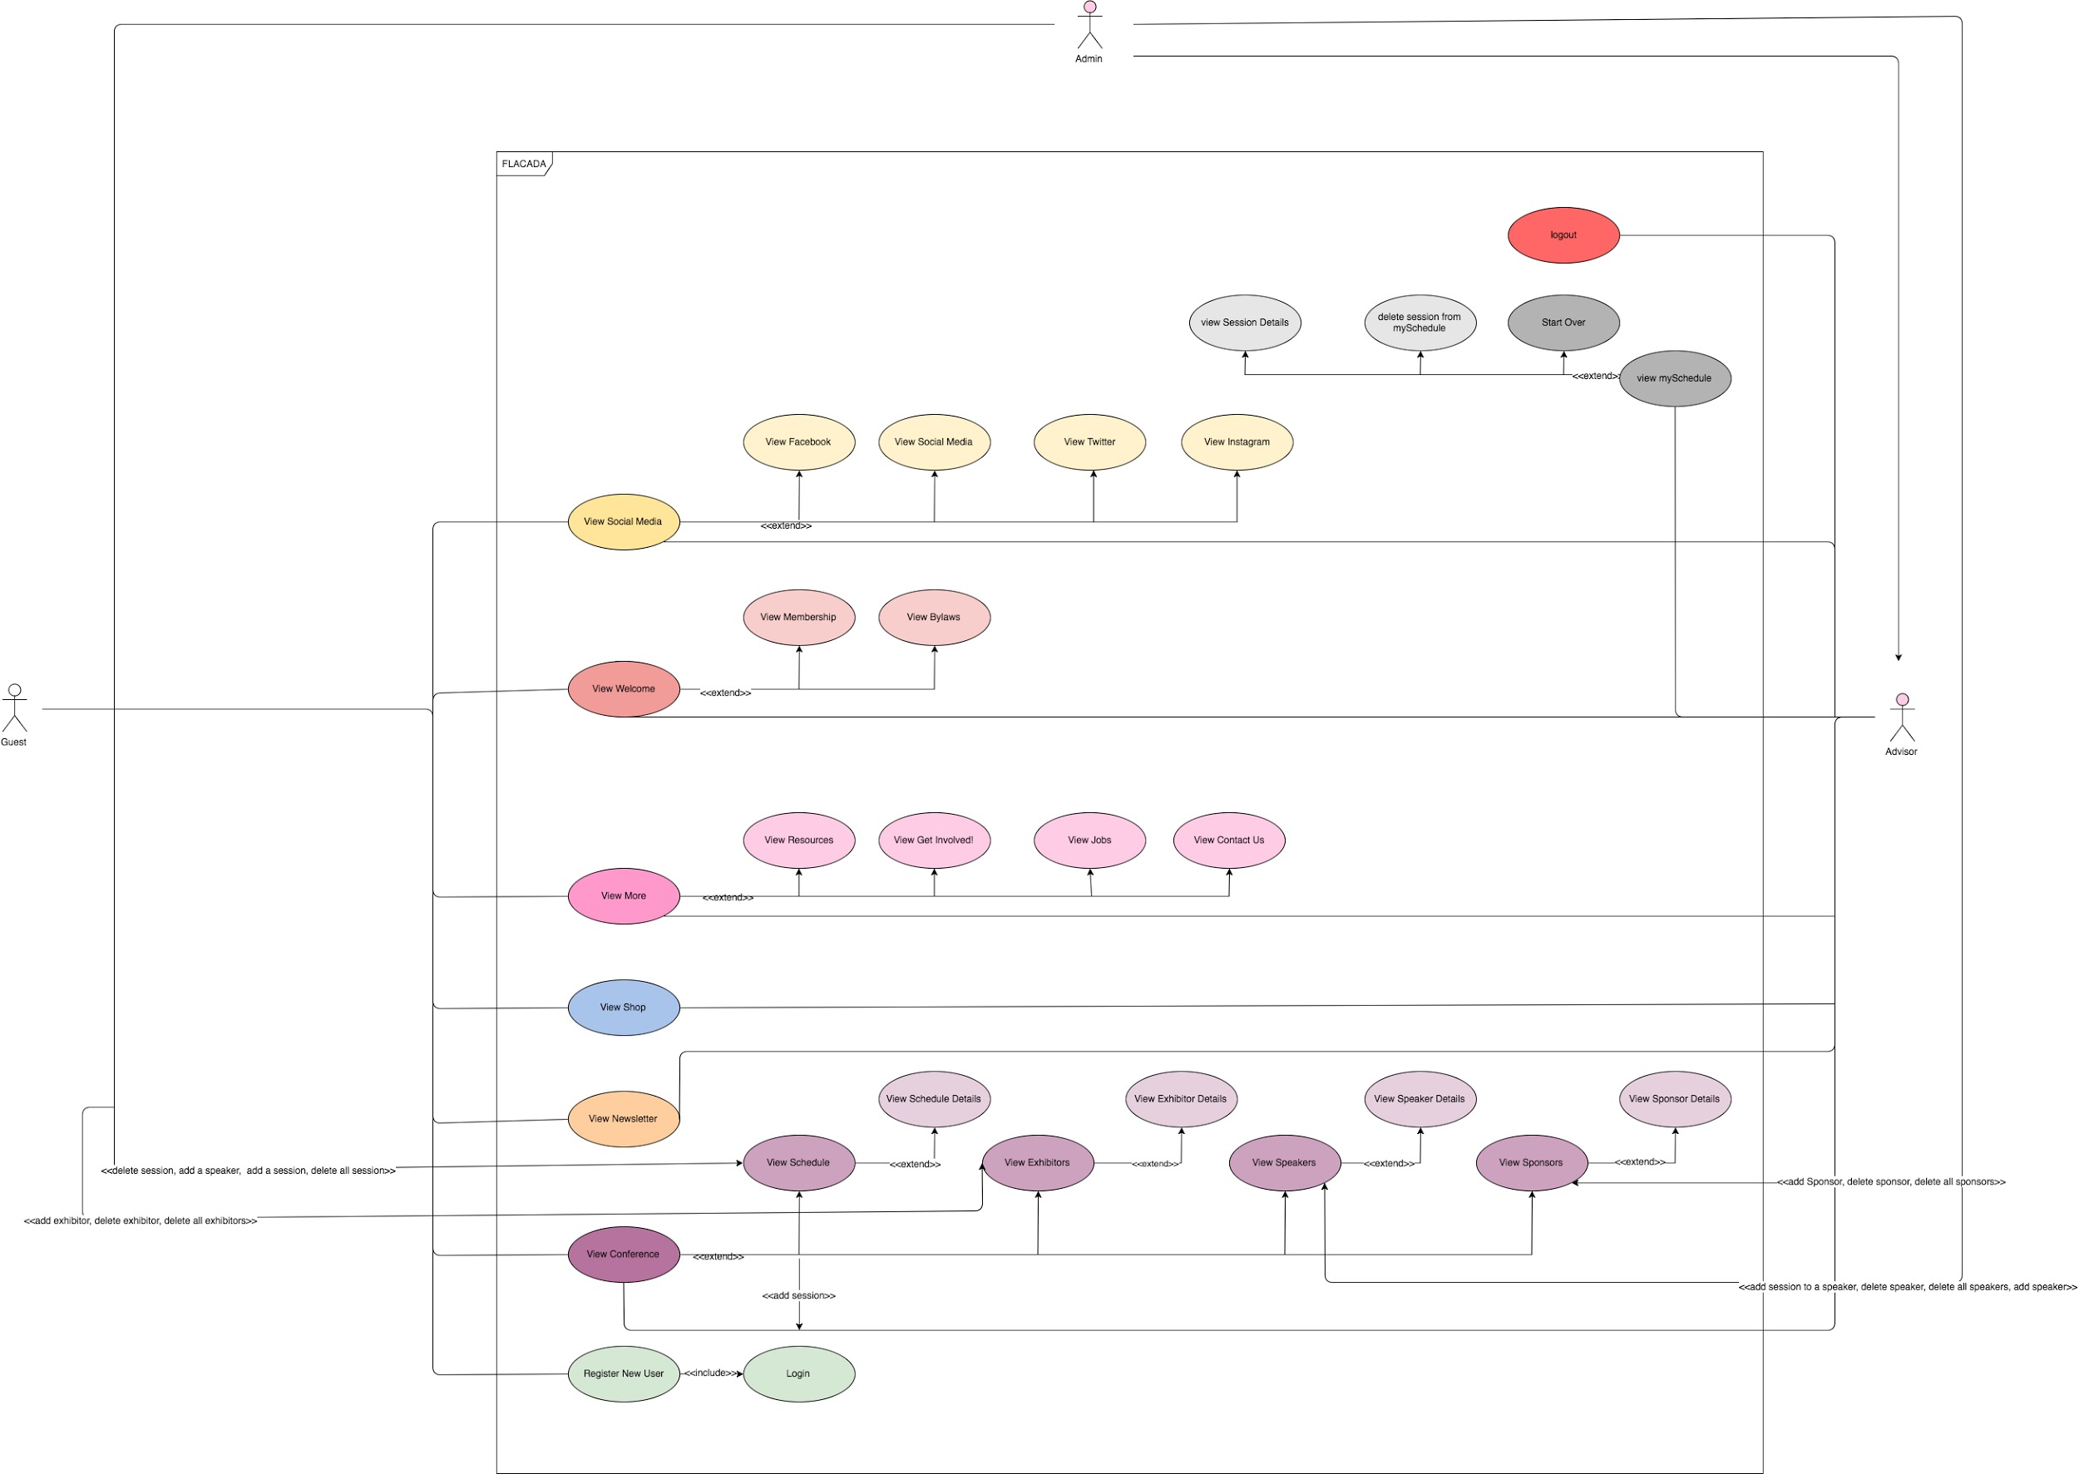
Requirements: Use Cases
Notes:
5 seconds
Show the Use Case Diagram for the whole project. Highlight your use cases.

Slide 5
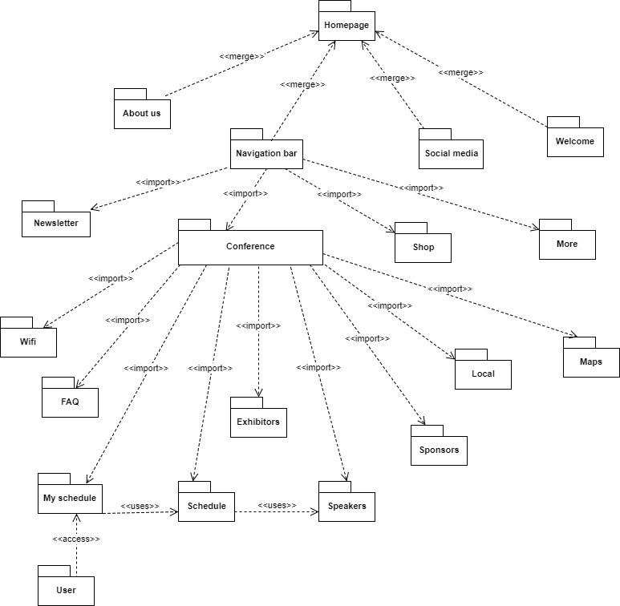
System Design: Architecture
Hardware requirements Any computer with at least the following specs: Processor: 500-Mhz Pentium-class or Intel Min RAM: 256 MB Min Disk Space: 100MB Windows OS: Windows XP OS X: OS X 10.5.8 Linux: Unbuntu 10.04 Software requirements Internet Browser: such as Chrome, Safari Text Editor: such as Atom, VS Code CMD Line: such as Terminal MongoDB MLab Express Angular NodeJS
Notes:
20 seconds
System design: Highlight the parts that you contributed to them.
1. System decomposition; identify the architecture patterns used
2. System deployment – h/w and s/w requirements

Slide 6
Architecture patterns
Our architecture is MVC. MVC stands for model-view-controller, and its an architecture that aims to separate out the data (model), the display (view), and application logic (controller). This separation aims to remove any tight coupling between the components, theoretically making code more maintainable and reusable.
MEAN Stack is comprised of four main technologies, with a cast of supporting technologies:
MongoDB - the database
Express - the web framework
Angular - the front-end framework
Node.Js - the web server
MEAN Stack pulls together some of the “best-of-breed” modern web technologies into a powerful and flexible stack. The thing that makes MEAN Stack stand out is the fact that you only need to know one language and its the same language you browser runs on: Javascript.

Slide 7
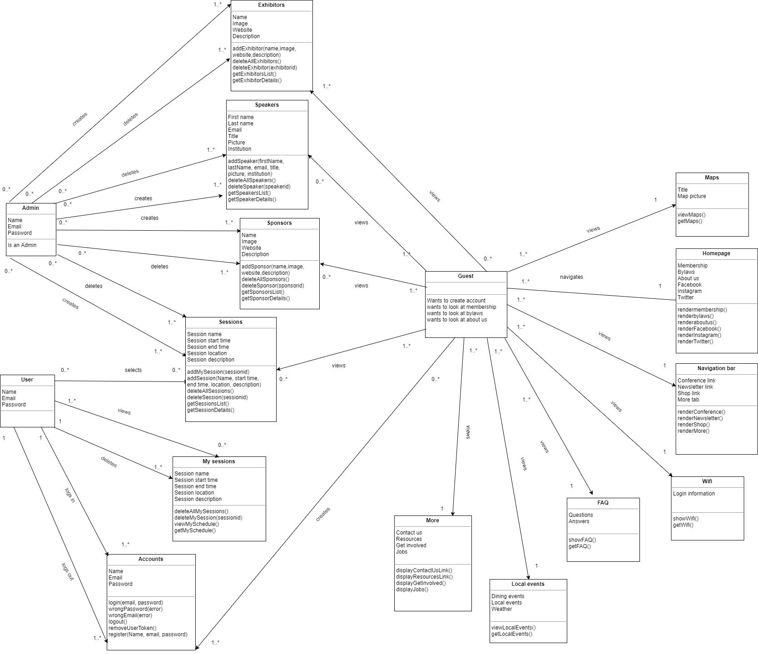
Minimal Class Diagram
Notes:
10 seconds.Minimal class diagram. Highlight the classes that you created/modified
Identify the design patterns used (one or more slides).

Slide 8
Design patterns
We used the Command Design Pattern which its intent is to encapsulate request objects and promote “invocation of a method on an object” to full object status and an object oriented call back. Command decouple that object that invokes the certain operation from the logic. To do this we design OO base classes that maps a receiver with some action that the object can “do”. This separation provides flexibility in the timing and sequencing of commands. Materializing commands this way means they can be manipulated like ony other object.

Slide 9
User Stories
User story: #753 - Create button to add sessions to my schedule
User story: #754 - Create button to delete sessions from my schedule
User story: #693 - Implement my schedule page
User story: #724 - Implement create sessions
User story: #756 - Implement create speakers
User story #685 - Implement the homepage
User story #689 - Create exhibitors and sponsors views
User story #692 - Create a resources button
User story #704 - Create view for sessions
User story #712 - Create view for speakers
User story #713 - Create contact us button
User story #714 - Create get involved button
User story #715 - Create jobs button
Notes:
5 seconds.
List the user stories that you worked on them.(put in order of importance). Stay focused on the parts that you have been working.

Slide 10
User story #724 - Implement create sessions
User story #725 - Implement register
User story #749 - Implement delete sessions
User story #750 - Implement delete speakers
User story #757 - Implement login
User story #758 - Implement logout
User story #734 - Create local page
User story #735 - Create wifi page
User story #694 - Implement create exhibitors
User story #759 - Create maps page
User story #760 - Create FAQ page
User story #755 - Implement create sponsors
User story #752 - Implement delete exhibitors
User story #751 - Implement delete sponsors

Slide 11
User story: #753 - Create button to add sessions to my schedule
Description:
As a user, I would like to add sessions to my schedule so that I can create my own schedule for the conference
Acceptance Criteria:
Every session on the schedule page has an add to my schedule button
If a session is successfully added to my schedule, a message is shown
Related Tasks:
Task #781 - Service to add sessions to my schedule
Task #780 - Controller and view to add sessions to my schedule
Task #779 - API routing to add sessions to my schedule
Notes:
60 seconds
The tile of user story
The most important user story you worked on it. You have to describe this one very well and be proud of that.
Please present and show the complexity of your work, code, algorithms, and technical challenges and technologies you have used. (you could use screenshot if you want. Visual presentations are better than text presentation)
Go into the details of the most important/significant tasks using bullet lists or visual graphs or state chart diagram
Sequence Diagram for this user story is mandatory (in another separate page if required)
Demo using screenshots or GIF (in another separate page if required)

Slide 12
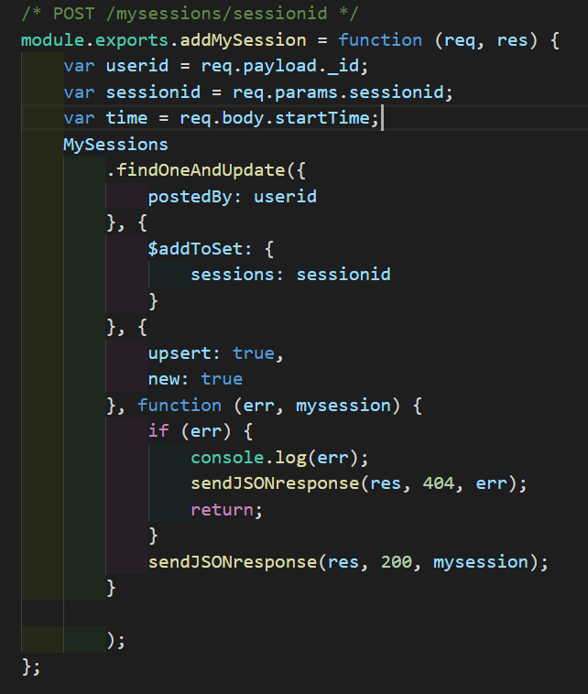
Task #779 API routing to add sessions to my schedule
With this function, we get the user id of the user from the payload. We also get the id of the session the user wants to add to their schedule from the url, and then we look up the user on the database and save the session id to their list of sessions.

Slide 13
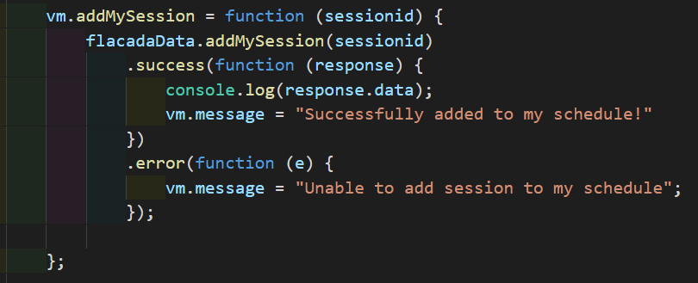
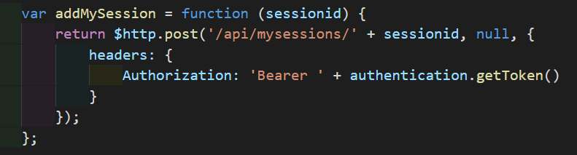
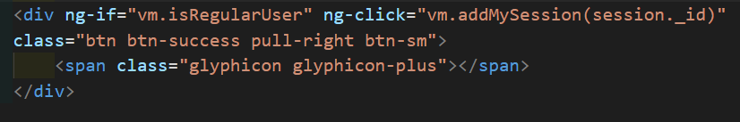
Task #780 and #781
With Angular, first we have to create a service file where we create a function to send the information to the server to add a session to my schedule. Then, in the controller we inject that service and call that function. Finally, we can use the function from the controller into our html file

Slide 14
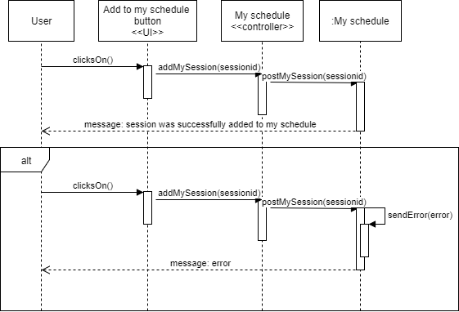
Sequence Diagram

Slide 15
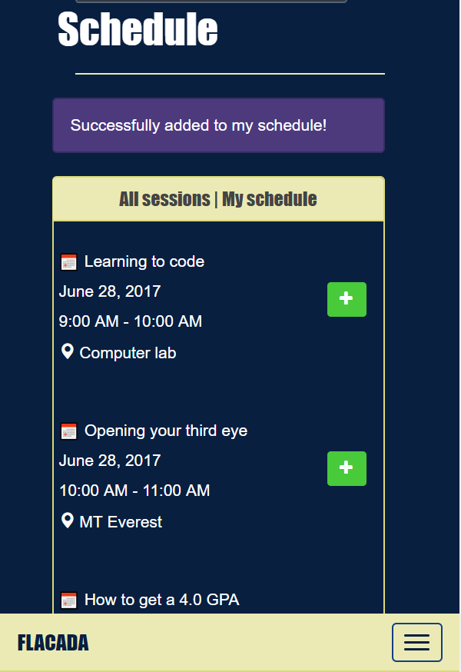
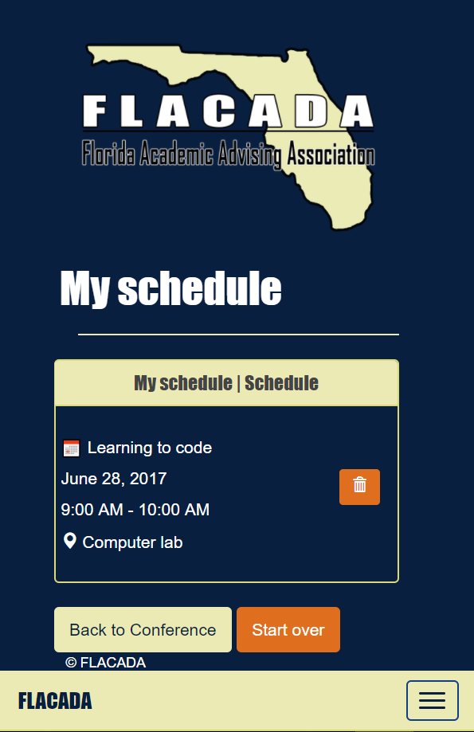

Slide 16
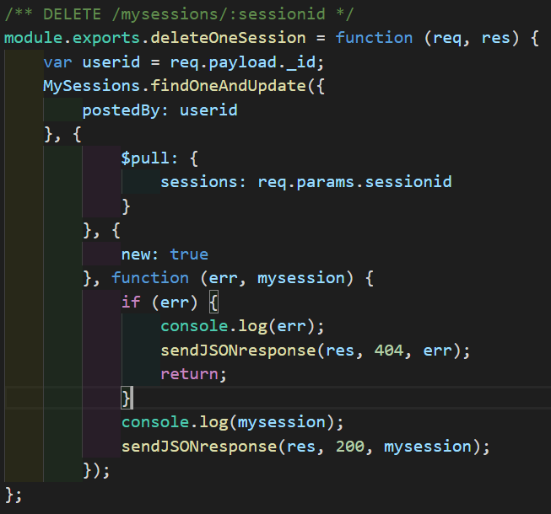
User story: #754 - Create button to delete sessions from my schedule
In this function, we also get the user id from the payload, we look up the user in the database. Then, we use the id of the session that the user wants to delete from the url and we delete it from the user’s list of sessions
Notes:
20 seconds
The tile of user story
Please present and show the complexity of your work, code, algorithms, and technical challenges and technologies you have used. (you could use screenshot if you want. Visual presentations are better than text presentation) - Go into the details of the most important/significant tasks using bullet lists or visual graphs or state chart diagram - Demo using screenshots or GIF (in another separate page if required)
Sequence Diagram for this user story is optional

Slide 17
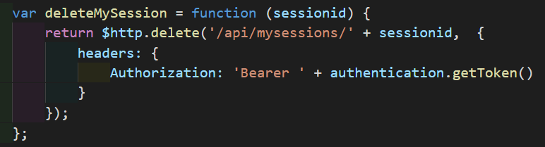
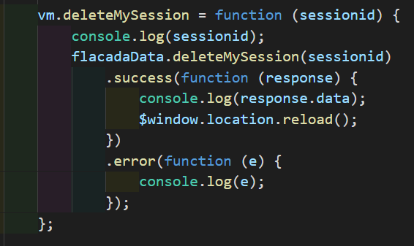
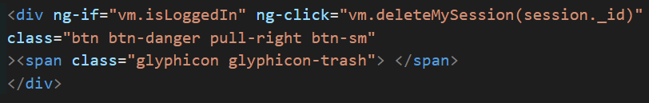
In our service file, we add a function to delete the session from the user’s schedule from the database. Then, in the controller, we call our delete function and use it in our html.

Slide 18
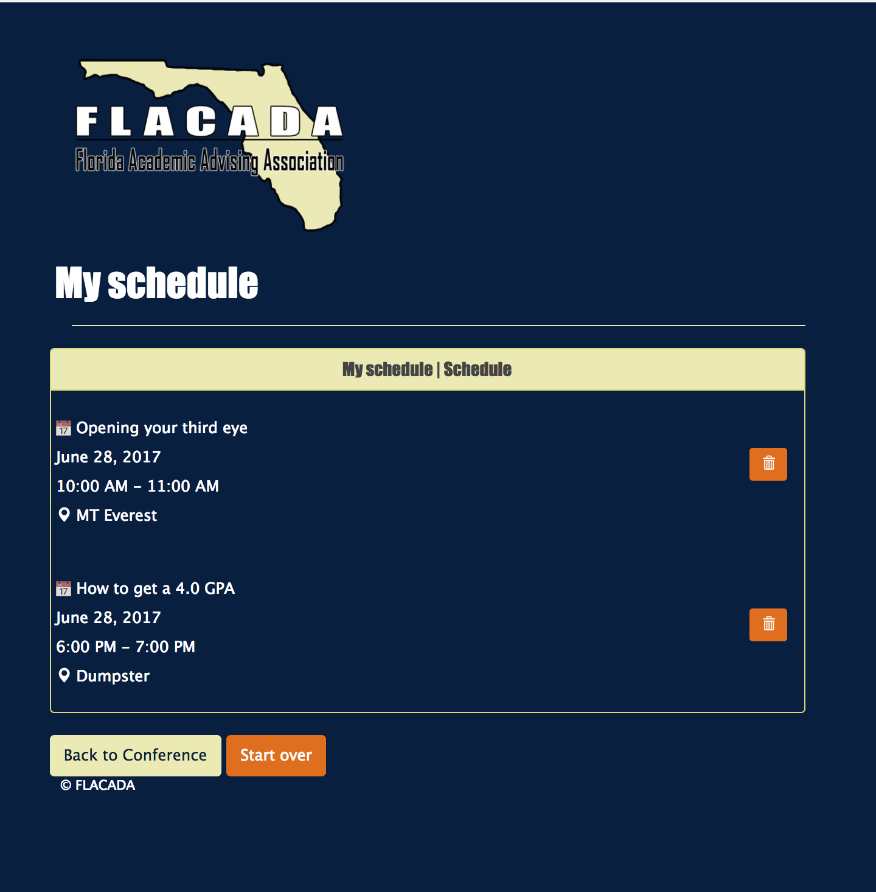
User story: #693 - Implement my schedule page
Notes:
20 seconds
The tile of user story
Please present and show the complexity of your work, code, algorithms, and technical challenges and technologies you have used. (you could use screenshot if you want. Visual presentations are better than text presentation) - Go into the details of the most important/significant tasks using bullet lists or visual graphs or state chart diagram - Demo using screenshots or GIF (in another separate page if required)
Sequence Diagram for this user story is optional

Slide 19
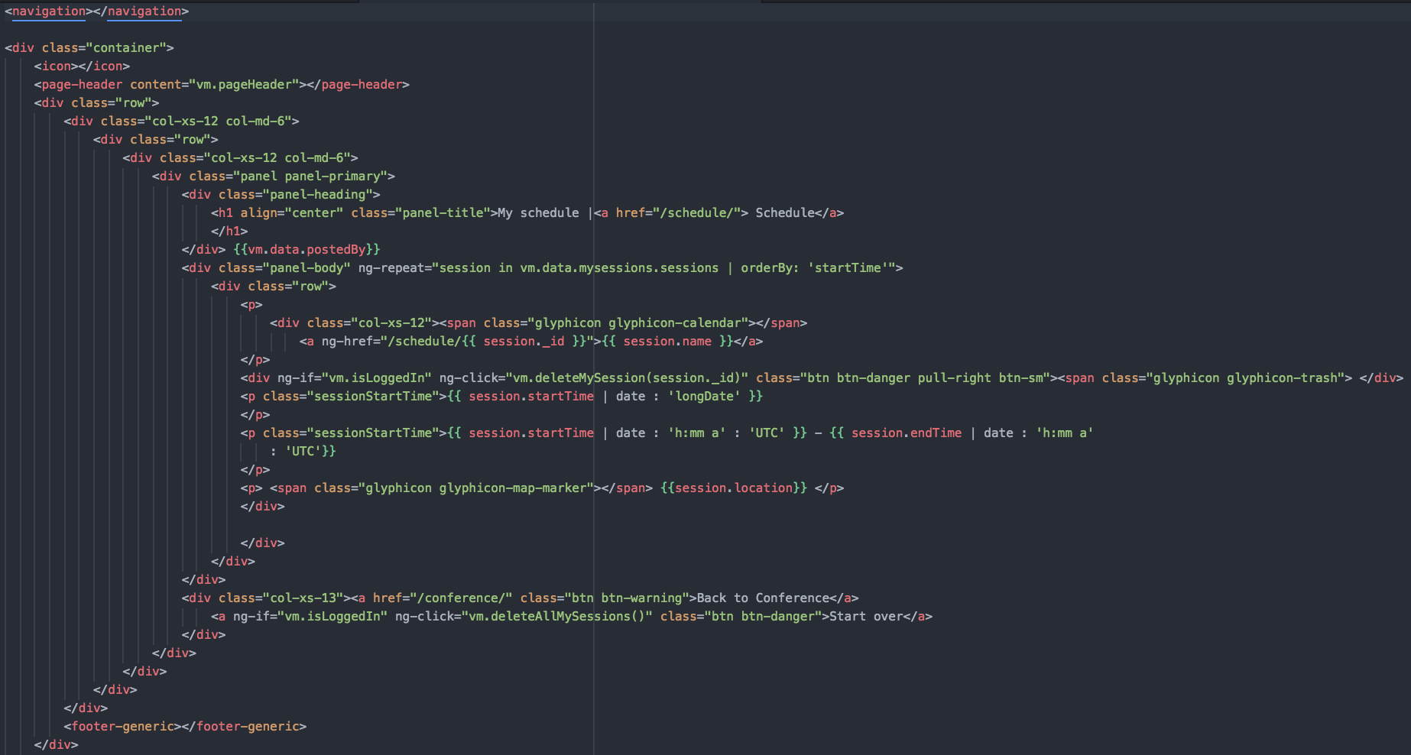
This HTML page constructs the mySchedule page with angular injected variables where the data will be fed from the controllers.

Slide 20
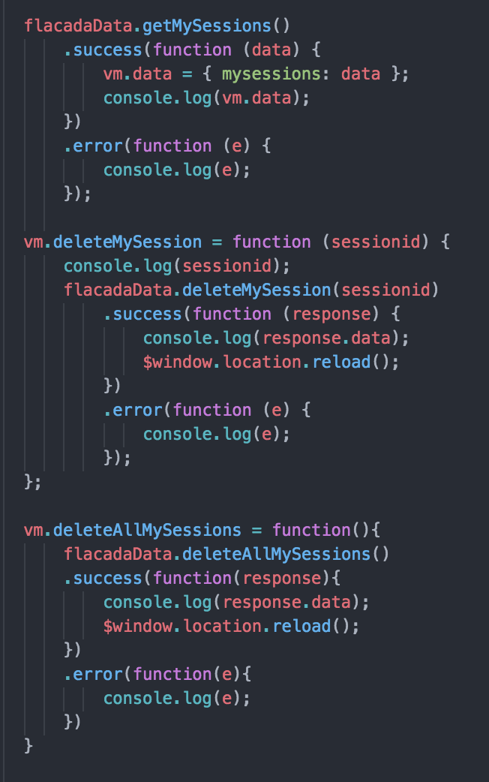
This is the controller where the magic happens, here we’re talking to the API with the corresponding functions and then we feed it to the previously shown HTML.

Slide 21
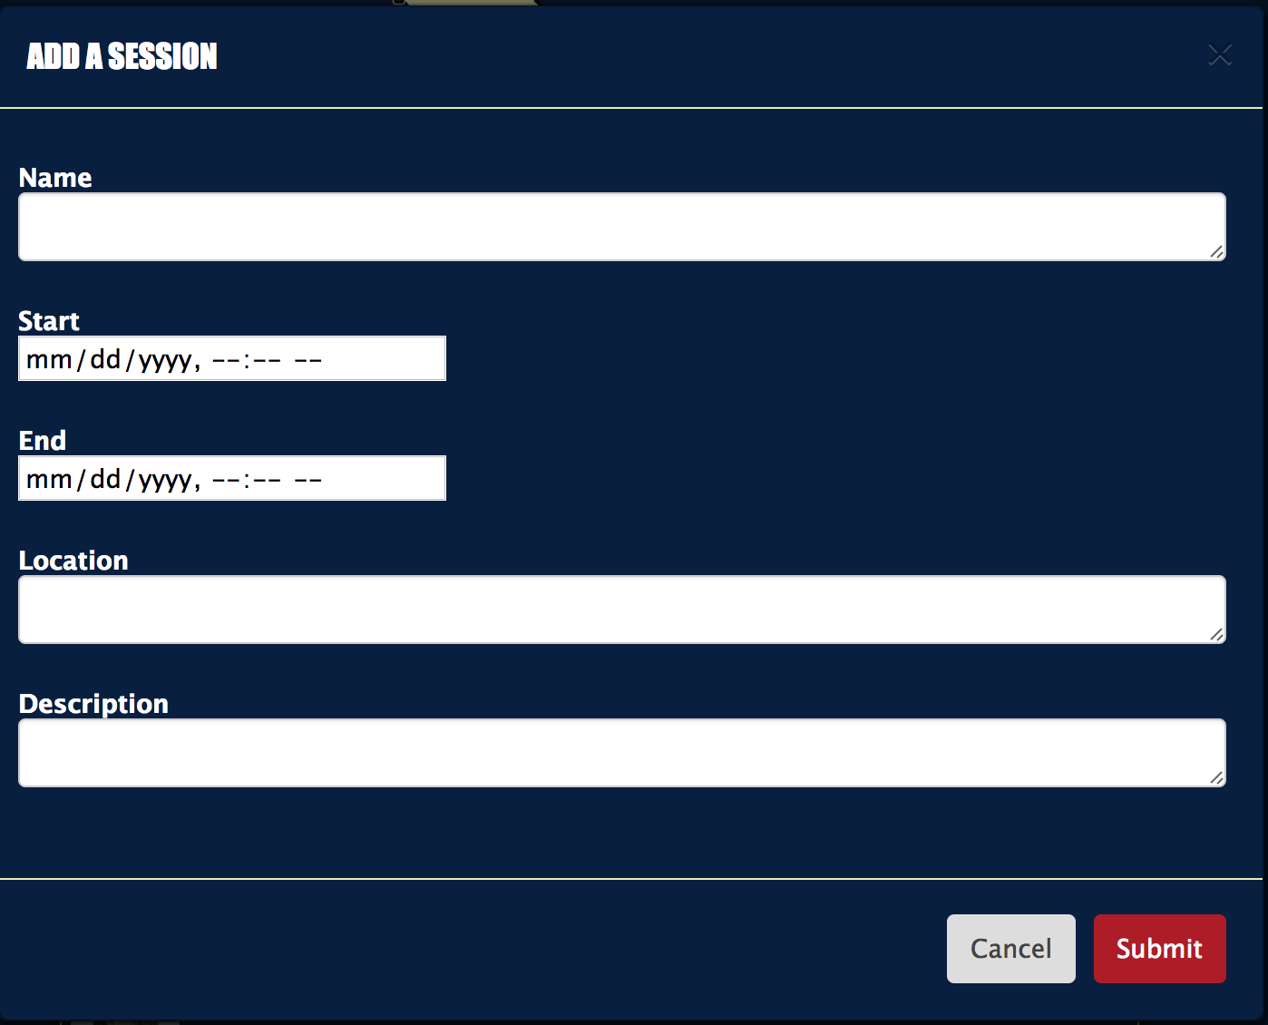
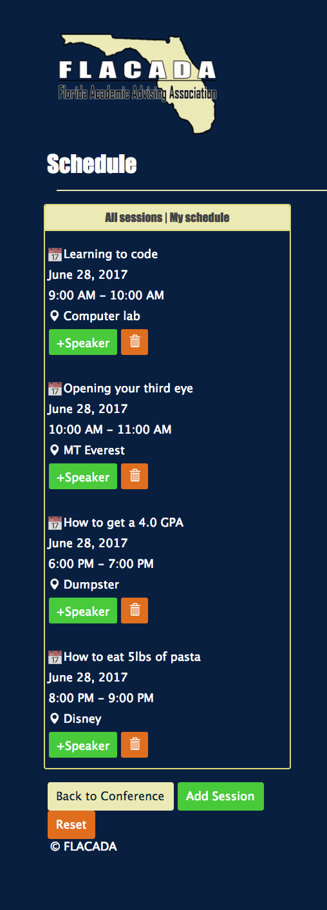
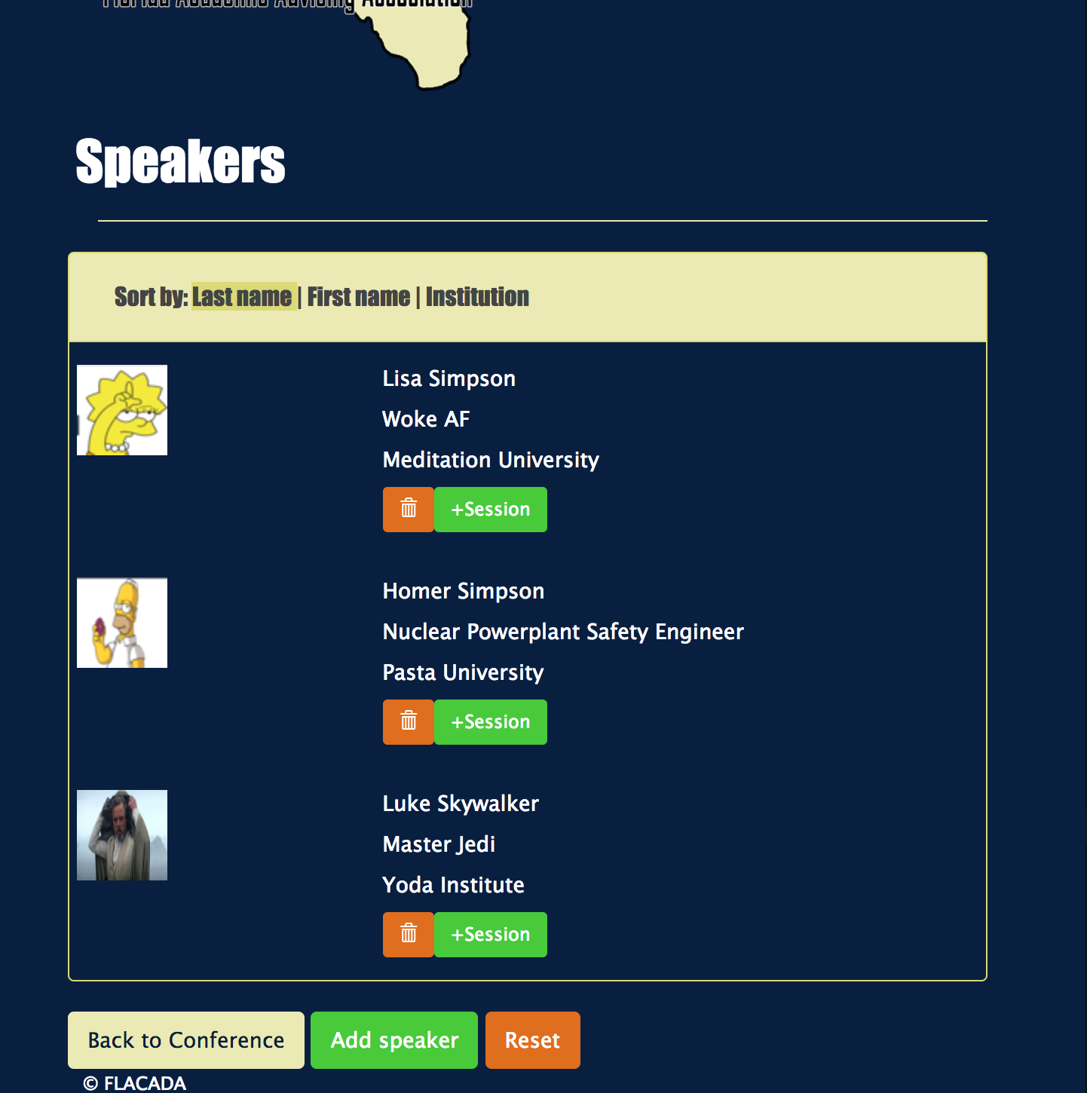
User story: #724 - Implement create sessions
Notes:
20 seconds
The tile of user story
Please present and show the complexity of your work, code, algorithms, and technical challenges and technologies you have used. (you could use screenshot if you want. Visual presentations are better than text presentation) - Go into the details of the most important/significant tasks using bullet lists or visual graphs or state chart diagram - Demo using screenshots or GIF (in another separate page if required)
Sequence Diagram for this user story is optional

Slide 22
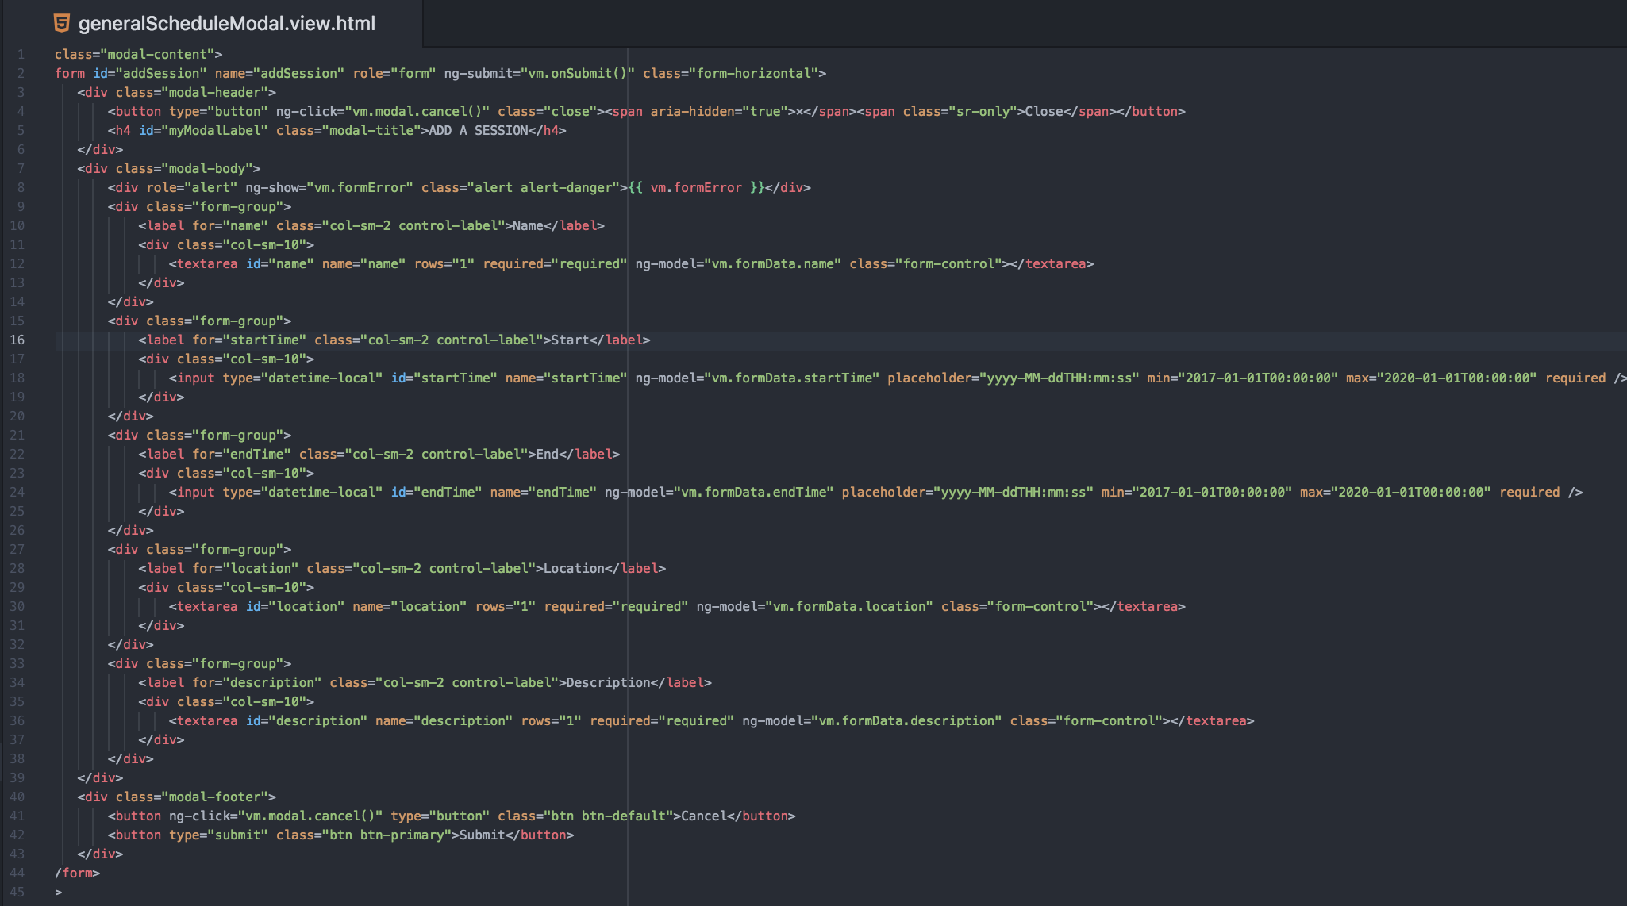
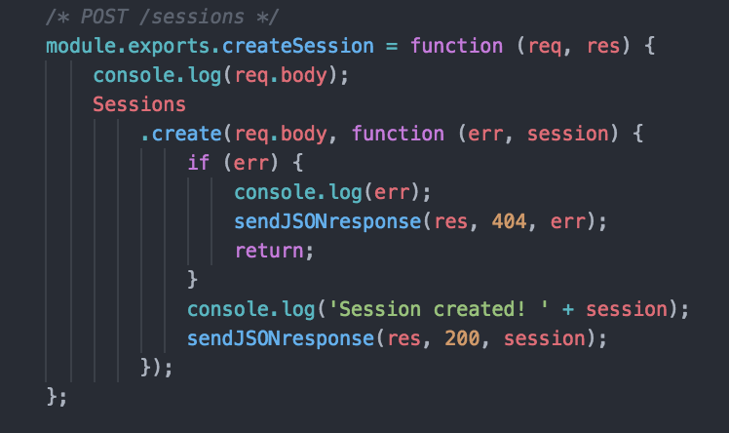
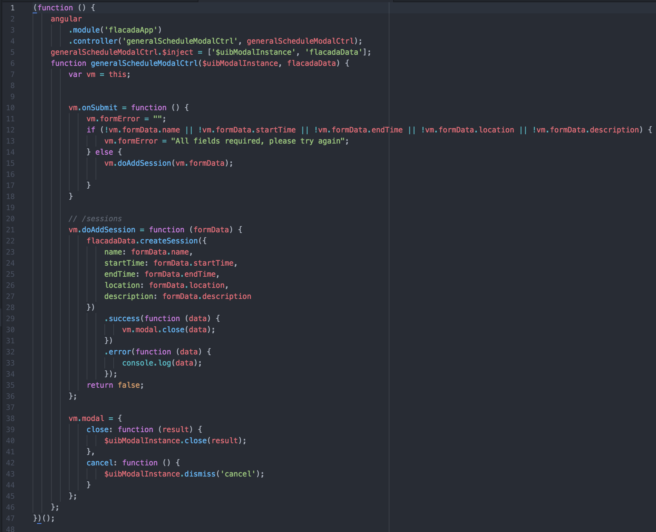
Create General Session
First we make the form to add a session, then we feed the variables in the the HTML with its corresponding controller and then the controller talks to the API.

Slide 23
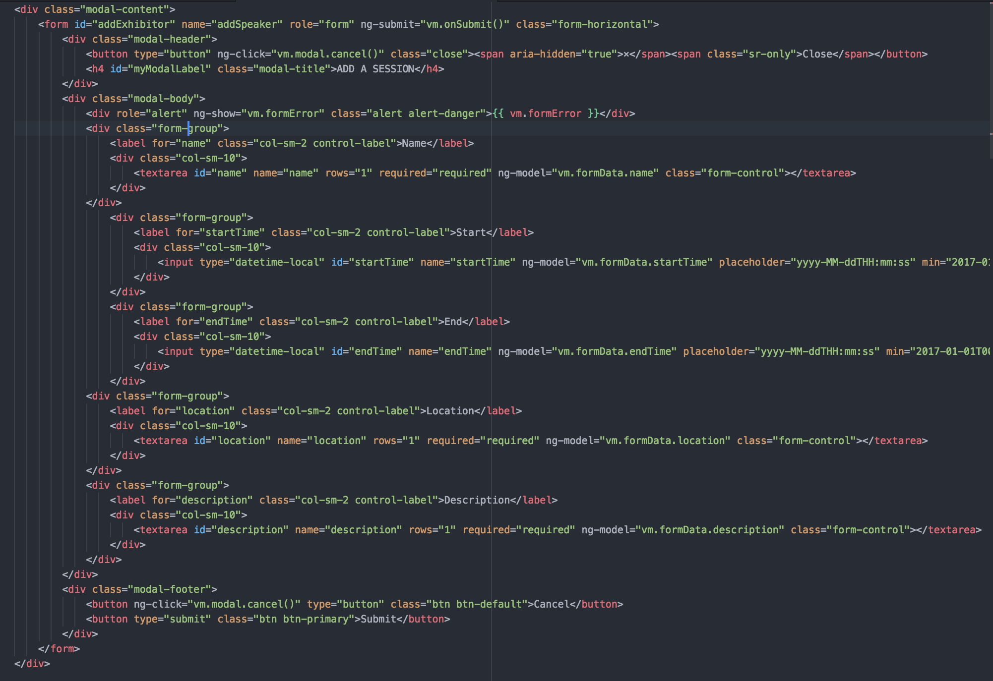
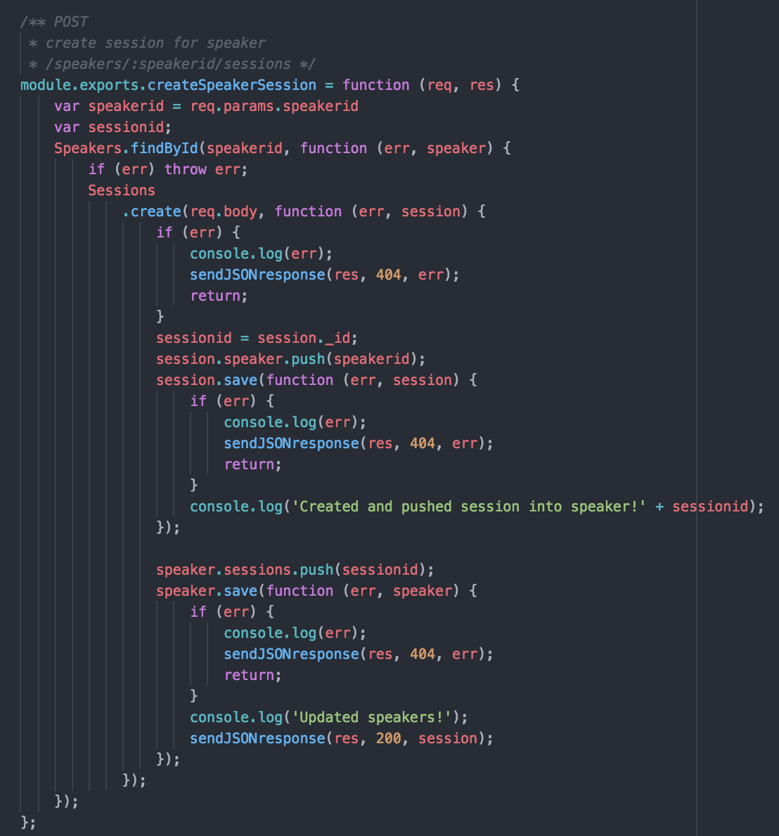
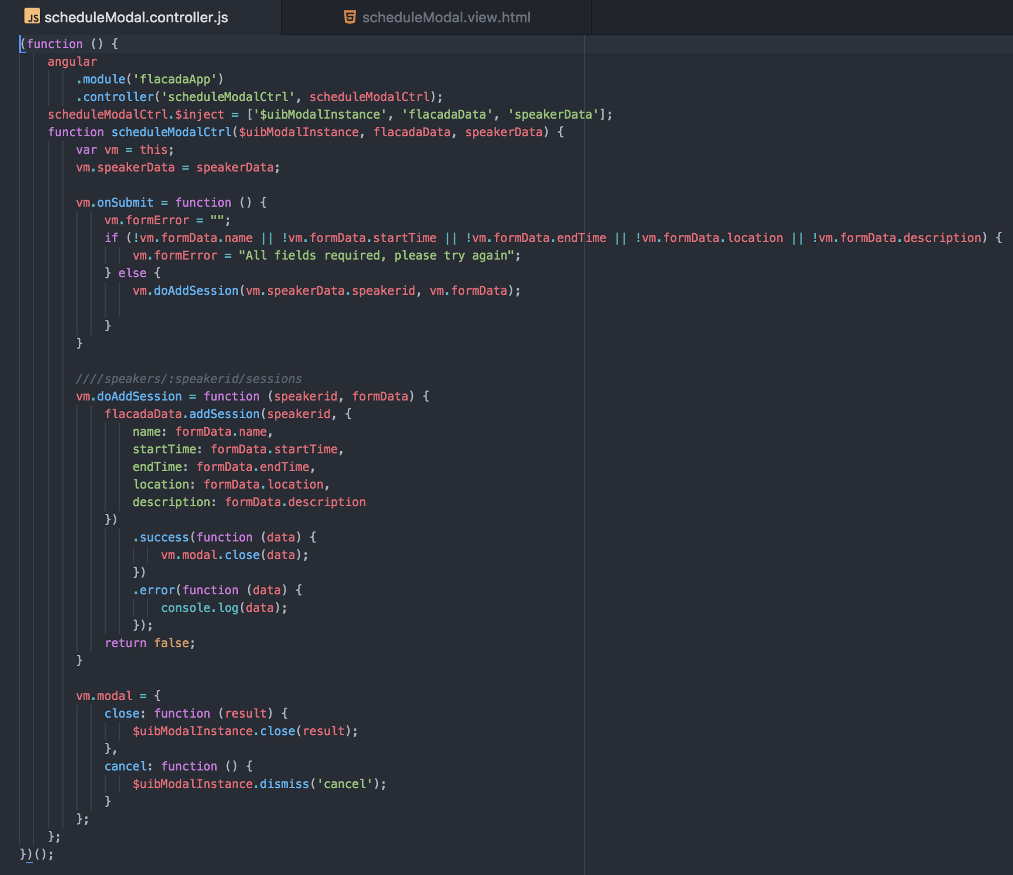
Add Session to an existing Speaker
The only difference between this functionality and the previous one is taking into account the speaker ID

Slide 24
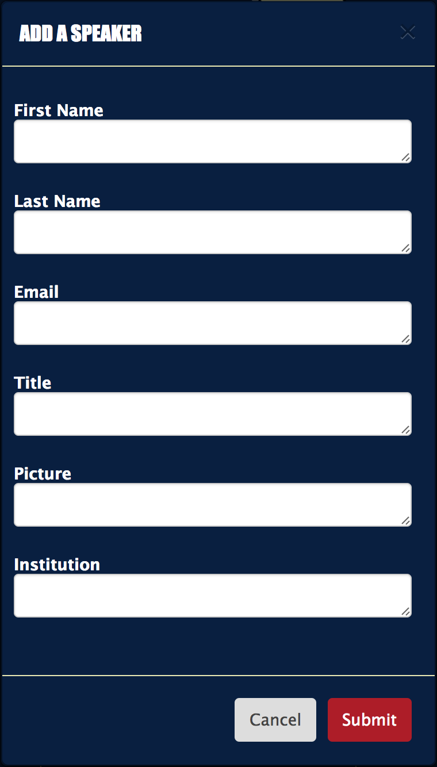
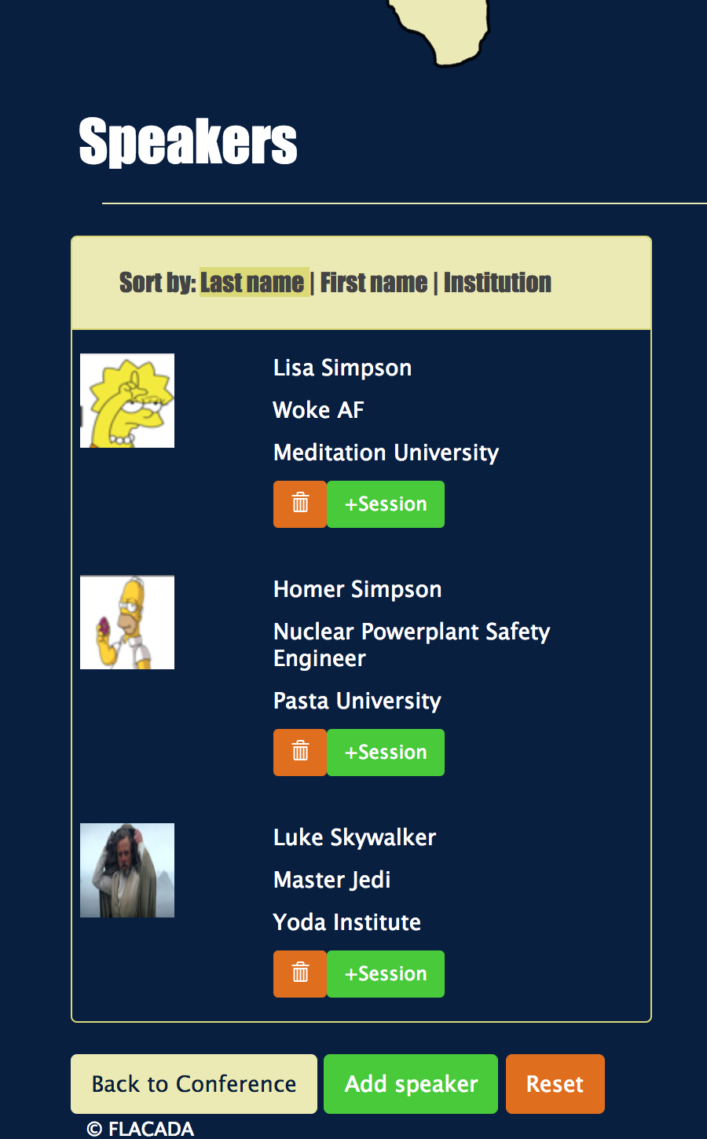
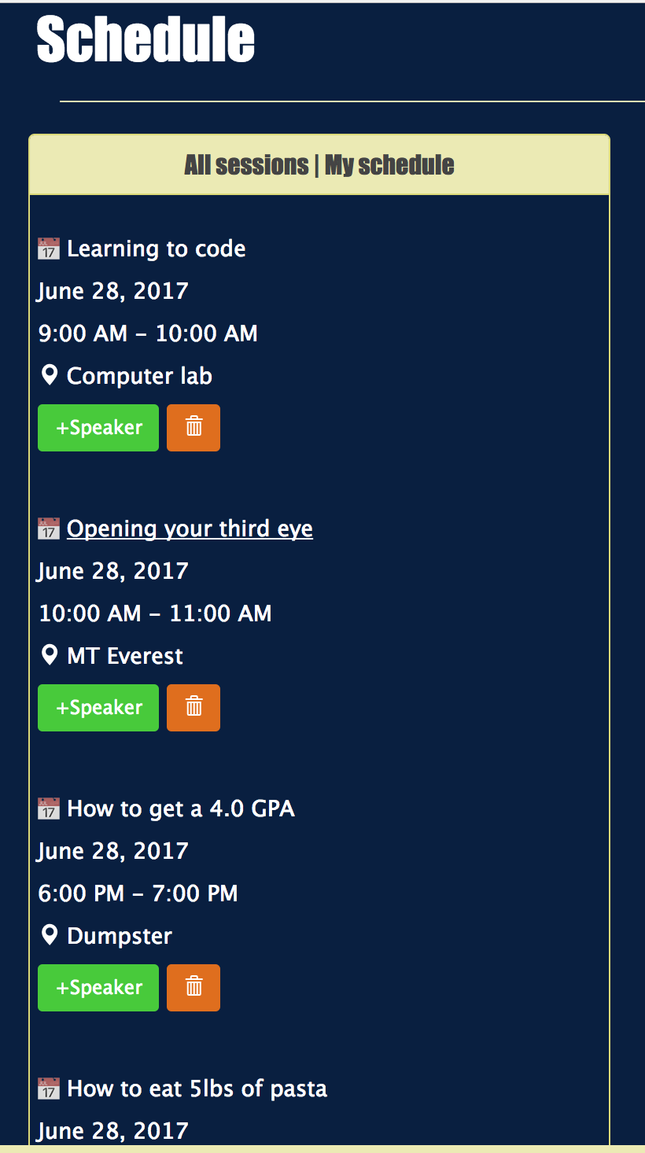
User story: #756 - Implement create speakers
Notes:
20 seconds
The tile of user story
Please present and show the complexity of your work, code, algorithms, and technical challenges and technologies you have used. (you could use screenshot if you want. Visual presentations are better than text presentation) - Go into the details of the most important/significant tasks using bullet lists or visual graphs or state chart diagram - Demo using screenshots or GIF (in another separate page if required)
Sequence Diagram for this user story is optional

Slide 25
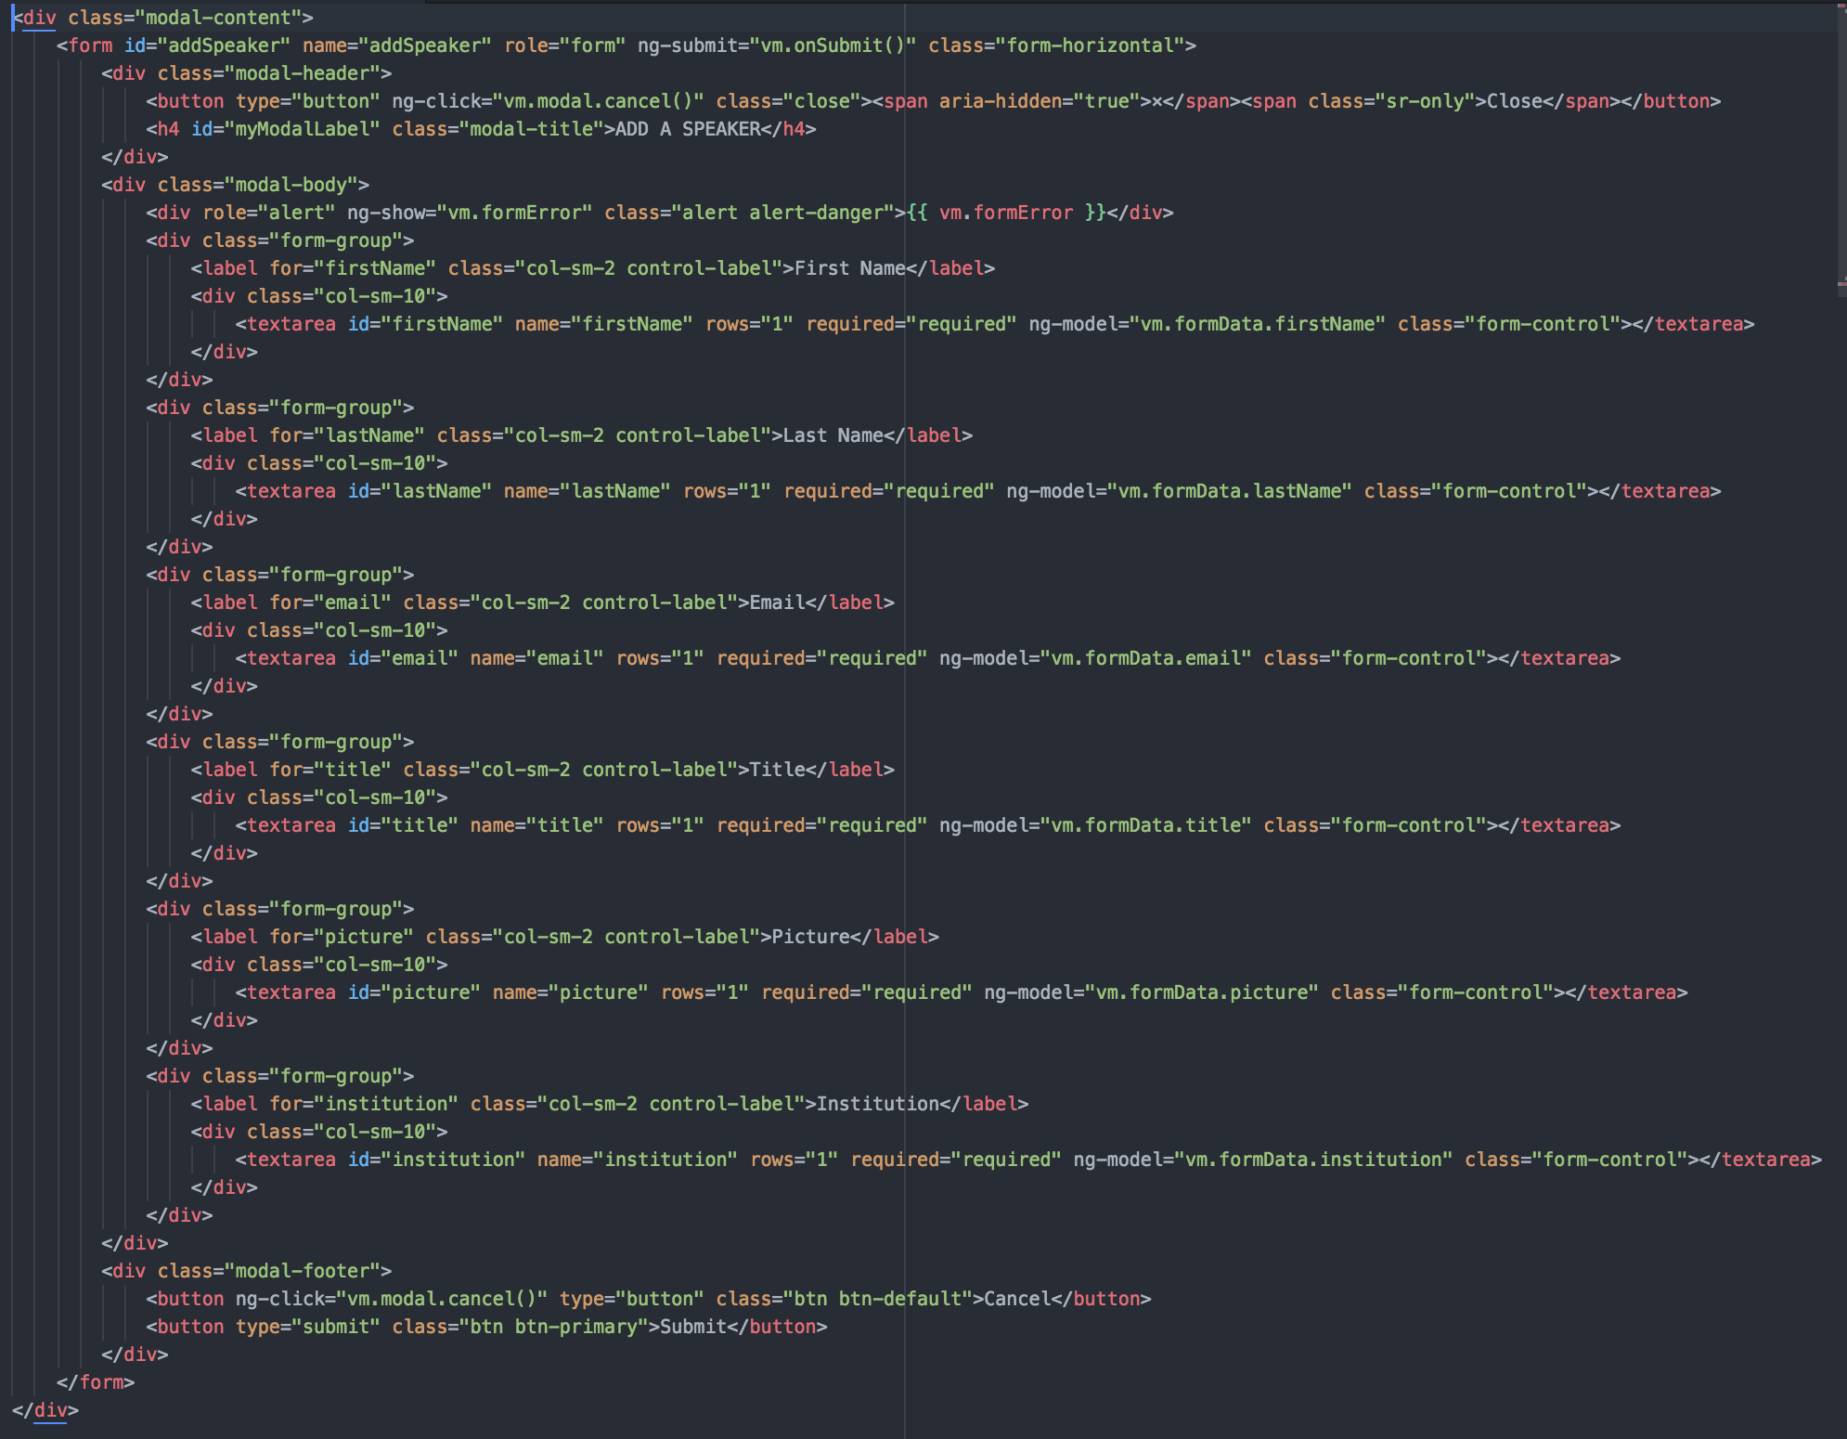
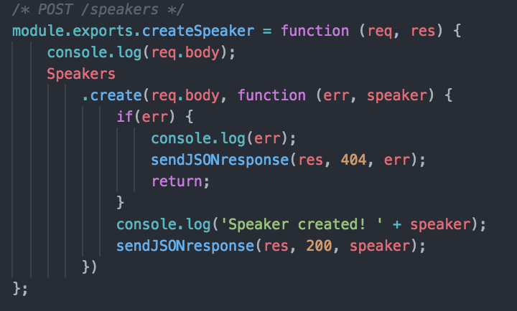
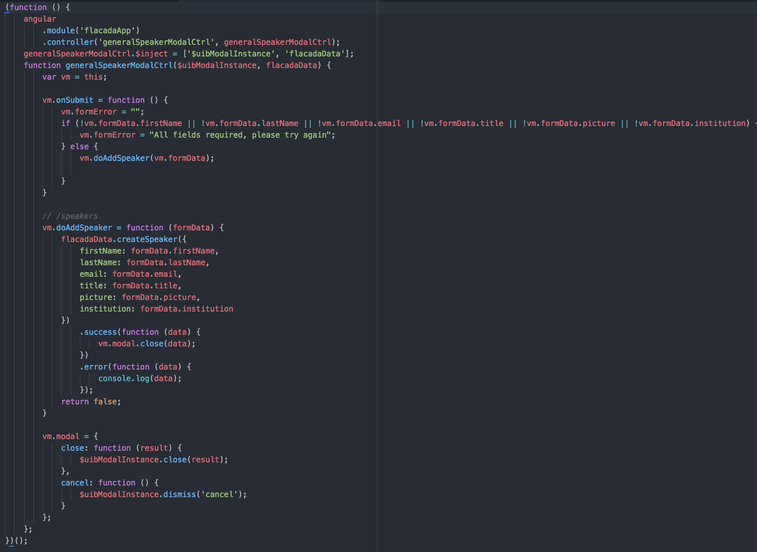
Create General Speaker
First we make the form to add a speaker, then we feed the variables in the the HTML with its corresponding controller and then the controller talks to the API.

Slide 26
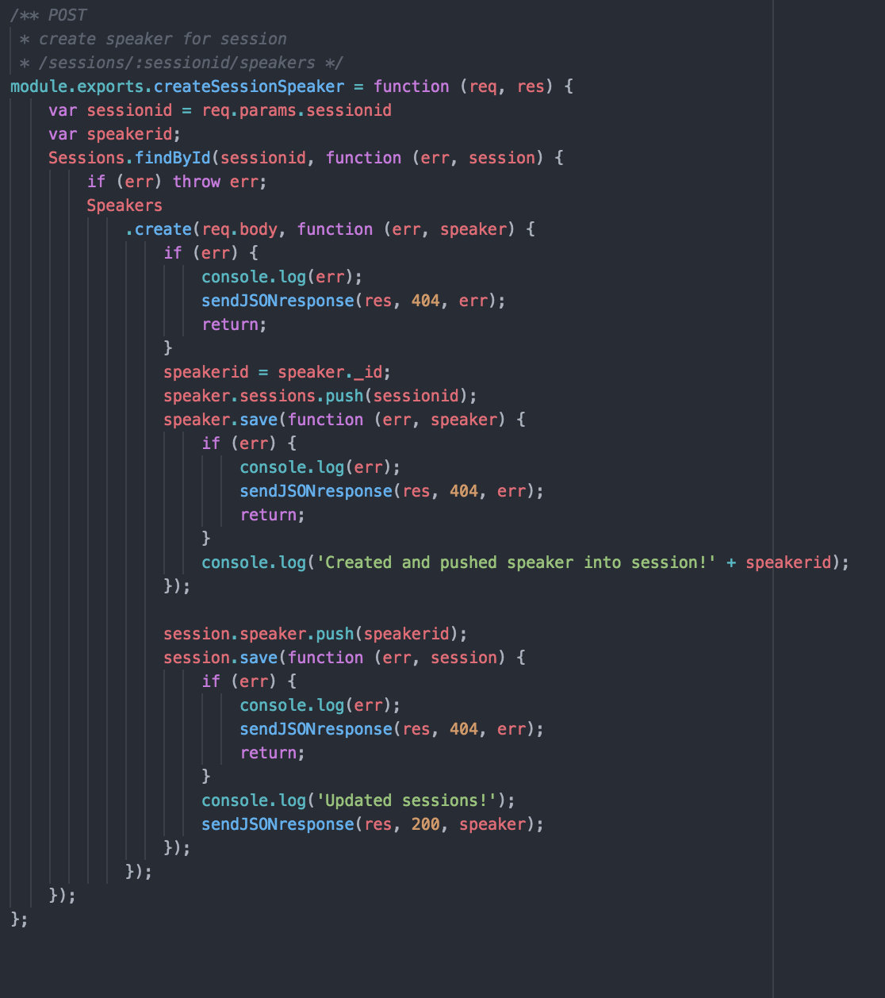
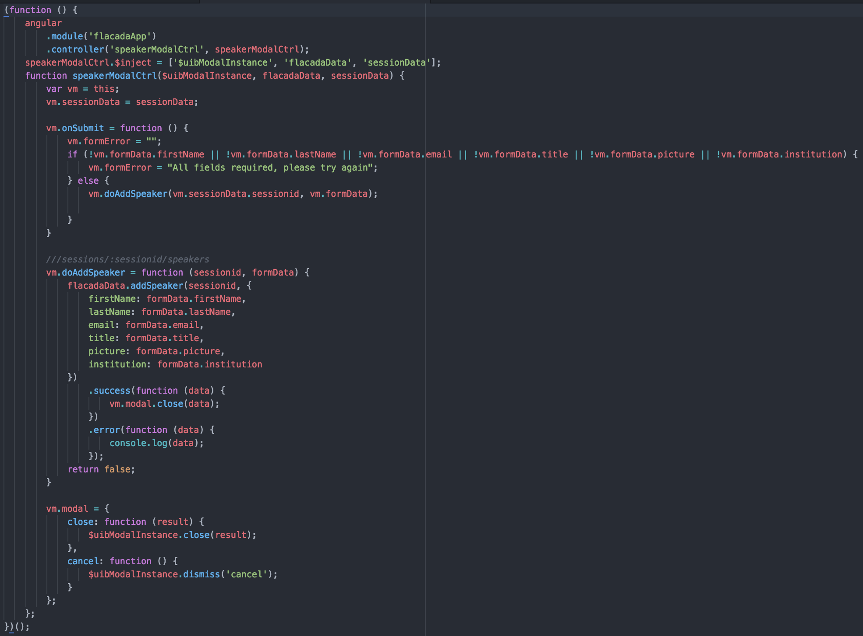
Add Speaker to an existing Session
The only difference between this functionality and the previous one is taking into account the session ID

Slide 27
User story: #753 - Create button to add sessions to my schedule
Test Cases
Test case ID: #25
Description/Summary of Test: User navigated to the Schedule Page and adds to their schedule certain sessions.
Pre-condition: Must be logged in as a User and the Sessions list must be populated.
Expected Results: Session was added to my schedule and is shown on the my schedule page
Actual Result: Session does not appear on the my schedule page
Status (Fail/Pass): FAIL
Notes:
10 seconds
A description of verification process and Test Suites and Test Cases for one of the use cases.
1 One sunny day and one rainy day for the implemented use cases (one or more slides).
2 Automated test scripts for the implemented use cases (if any) (one or more slides).

Slide 28
Test case
Test case ID: #26
Description/Summary of Test: User navigated to the Schedule Page and adds to their schedule certain sessions.
Pre-condition: Must be logged in as a User and the Sessions list must be populated.
Expected Results: Session was added to my schedule and is shown on the my schedule page
Actual Result: Session was added to my schedule and appears on my schedule.
Status (Fail/Pass): PASS

Slide 29
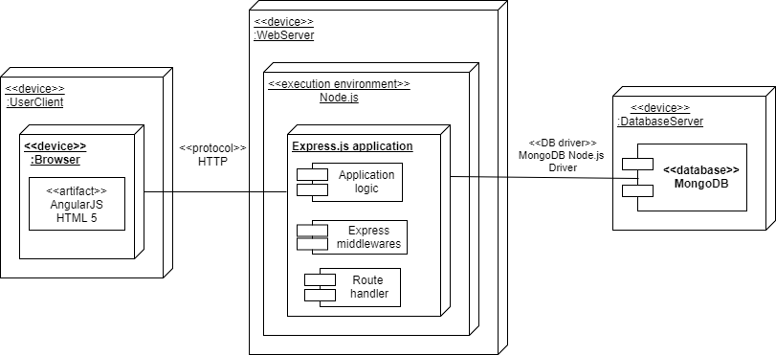
Deployment Diagram

Slide 30







Summary
FLACADA 1.0 is the first iteration of this app, we started from scratch using the MEAN stack framework for full stack web development. Allows users to see all exhibitors, sponsors, schedule sessions and see speakers from their respective conferences.The architecture is scalable and easy to change based on desired changes in functionality.
Nickolas Morales : nimorale.com
Mabel Amaya : mamay005@fiu.edu
Questions?
Thank You!
The logos of all technologies you have used
Notes:
10 seconds
Summarize your contribution, mention your effort for Scrum, Mingle, Github, Google Drive Documentation and minutes
Include your contact information
Ask if anyone has any questions for you.
Thank your audience

